Slide 1
Byzantine and Islamic

Slide 2
a.d. 476-a.d. 1453
During this time period we see very detailed art. Mosaics, architecture, and maze-like designs. Most art is found in the eastern Rome area

Slide 3
Hagia Sophia
Was a Christian church, then a mosque, now a museum.
Located in Istanbul, Turkey.
Said to be the turning point of architecture.
Epitome of byzantine architecture with it’s big dome.

Slide 5
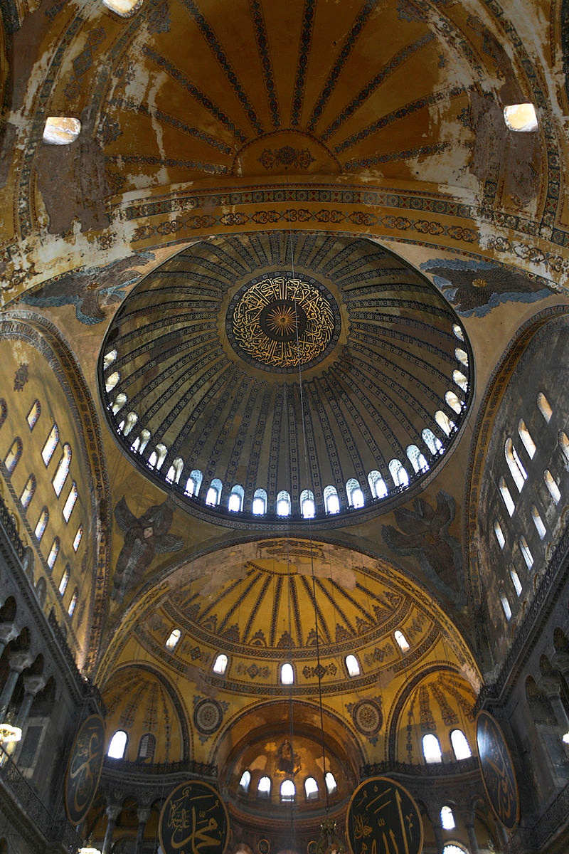

Slide 6
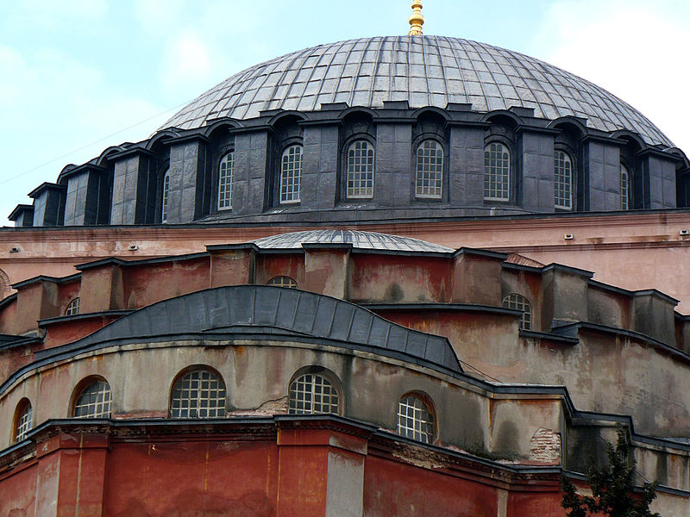

Slide 7
Mosque of Cordoba
Located in Spain, now serves as a cathedral.
Has been expanded by Muslim rulers

Slide 9
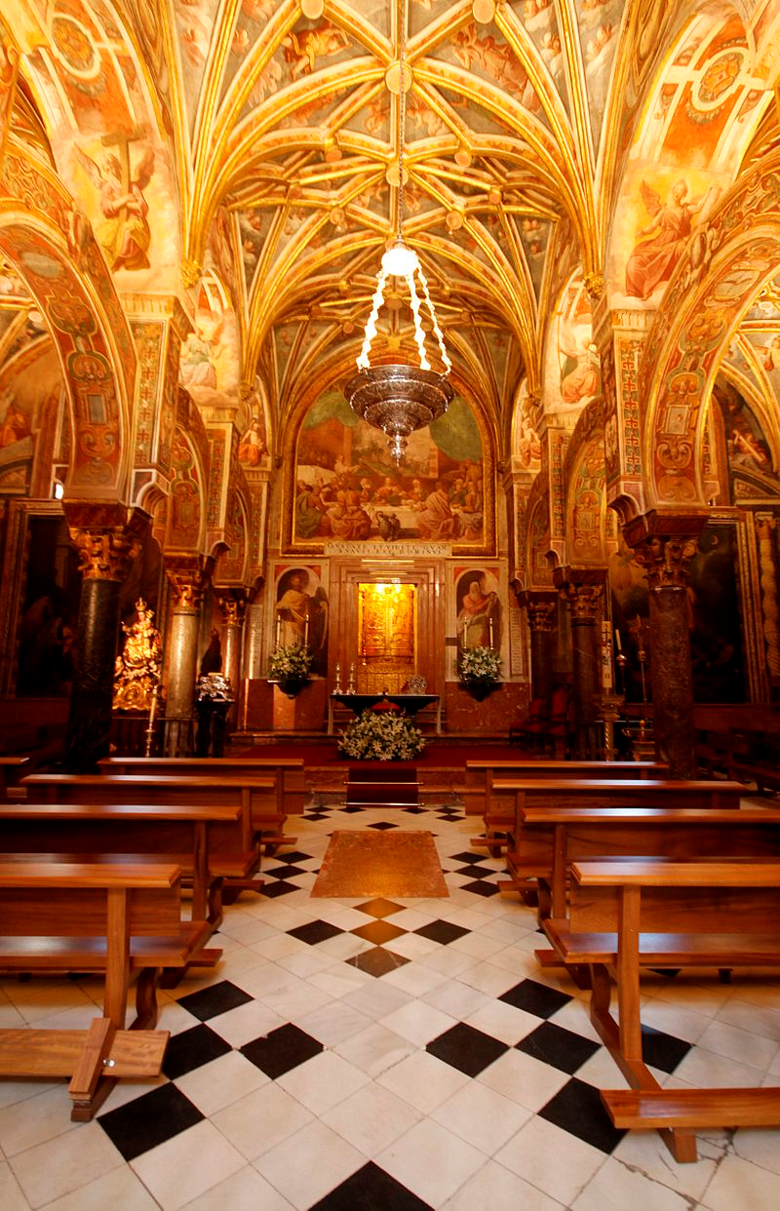

Slide 10
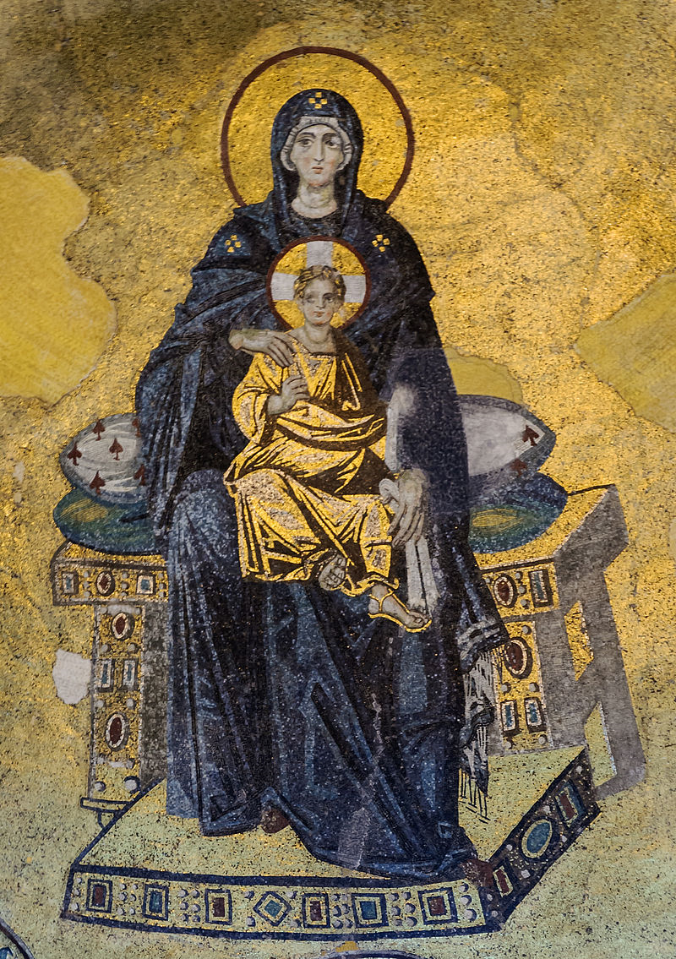
Apse mosaic of the Virgin and Child in hagia sophia

